Slide 1
ADVANCED CLASS MODELING

Slide 2
1.Advanced objects and class concepts
Enumerations
Multiplicity
Scope
Visibility

Slide 3
a.Enumerations (enum)
An enumeration is a way to have a type that has a defined number of possible values.
E.g. Attributes:
1. accessPermission can be an enumeration with possible values that include read and read-write.
2. Type is an enumeration that includes solid, dashed, and dotted.
3.TwoDimensional.fillType can be an enumeration that includes solid, grey, none, horizontal lines, and vertical lines.

Slide 4
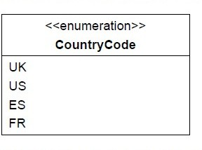
a.Enumerations (enum)
Example country code is represented as an enum. This had the possible values UK, US, ES, FR.
◆
In UML, we would write it as a class with two compartments. We would add the stereotype <<enumeration>> to the name; you might also see this as <<enum>>.
◆
◆
The attributes compartment would list the possible values.

Slide 5
Enumeration & Generalization
Generalization shall not be used to capture the values of an enumerated attribute.
Enumeration is merely a list of values; Generalization is a means for structuring the description of objects.
Generalization is introduced only when at least one subclass has significant attributes, operations, or associations that do not apply to the super-class.

Slide 6
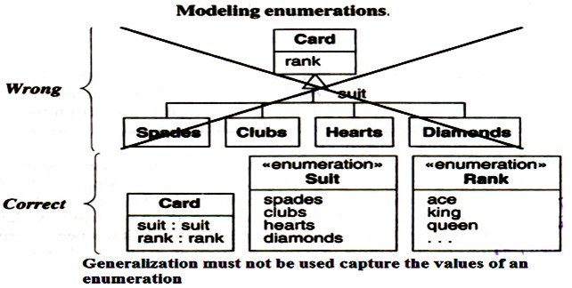
Example
Generalization for cards should not be used as most games do no differentiate the behaviour of spades, clubs, hearts and diamonds.

Slide 7

b. Multiplicity
Specify whether an attribute is single or multivalued, mandatory or optional.
Specifies the number of possible values for each instantiation of an attribute. The most common specifications are a mandatory single value [1], an optional single value [0..1], and many [*].
Multiplicity specifies whether an attribute is mandatory or optional (in database terminology whether an attribute can be null). Multiplicity also indicates if an attribute is single valued or can be a collection.
If not specified, an attribute is assumed to be a mandatory single value ([1]).

Slide 8
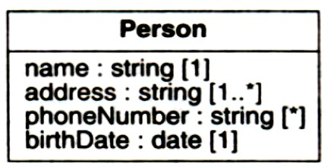
Example
A person has one name, one or more addresses, zero or more phone numbers, and one birth-date.

Slide 9

c. Scope
It indicates if a feature applies to an object or a class.
An underline distinguishes features with class scope (static) from those with object scope.
Convention is to list attributes and operations with class scope at the top of the attribute and operation boxes, respectively.

Slide 10
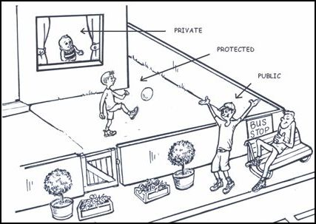
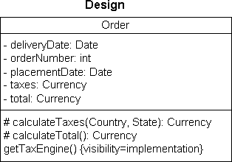
d. Visibility
◆
The class diagram will specify the accessibility for attributes and operations. The most common operators are:
+ public
# protected
- private
~package
•
•
•
•

Slide 11
Issues to be considered when choosing visibility:
Comprehension
Extensibility
Context

Slide 12
Comprehension
All public features must be understood to understand the capabilities of a class. In contrast, private, protected, and package features can be ignored-they are merely an implementation convenience.

Slide 13
Extensibility
Many classes can depend on public methods, so it can be highly disruptive to change their signature (number of arguments, types of arguments, type of return value). Since fewer classes depend on private, protected, and package methods, there is more latitude to change them.

Slide 14
Context
Private, protected, and package methods may rely on preconditions or state information created by other methods in the class. Applied out of context, a private method may calculate incorrect results or cause the object to fail.

Slide 15
2. Association Ends
As the name implies, an association end is an end of an association. A binary association has two ends, a ternary association has three ends, and so forth.
Association end name
Multiplicity
Ordering
Bags and Sequences
Qualifications
Aggregation
Changeability
Navigability
Visibility

Slide 16
Aggregation: The association end may be an aggregate or constituent part. Only a binary association can be an aggregation; one association end must be an aggregate and the other must be a constituent.
Changeability: It specifies the update status of an association end. The possibilities are changeable (can be updated) and read only (can only be initialized).
.

Slide 17
Navigability: Conceptually, an association may be traversed in either direction. However, an implementation may support only one direction. The UML shows navigability with an arrowhead on the association end attached to the target class. Arrowheads may be attached to zero, one, or both ends of an association
Visibility: Association ends may be public, protected, private, or package.

Slide 18

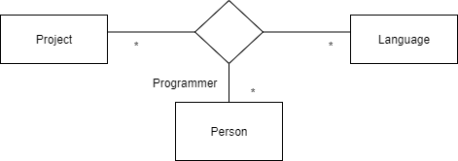
3.n-Ary Association
An n-Ary Association element is used to model complex relationships between three or more classes.
◆
It is not a commonly-employed device, but can be used to good effect where there is a dependant relationship between several classes.
◆
Any n-Ary association may be drawn as a diamond with a solid line for each association end connecting the diamond to the classifier that is the end’s type.
◆
◆
Most of n-ary associations can be decomposed into binary associations, with possible qualifiers and attributes. Hence they must possibly be avoided.

Slide 19
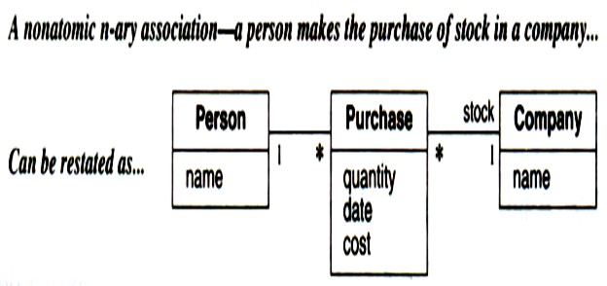
Example
Figure shows an association that at first glance might seem to be an n-ary but can readily be restated as binary associations.

Slide 20
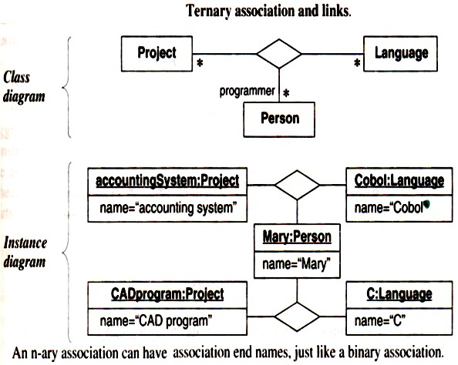
Example: n-ary (ternary) association

Slide 21
The UML symbol for n-ary associations:
A diamond with lines connecting to related classes.
If the association has a name, it is written in italics next to the diamond.
An n-ary association can have a name for each end just like a binary association. End names are necessary if a class participates in an n-ary association more than once.
n-ary associations can not be traversed from one end to another as with binary associations, so end names do not represent pseudo attributes of the participating classes.
The OCL [Warmer-99] does not define notation for traversing n-ary associations

Slide 22
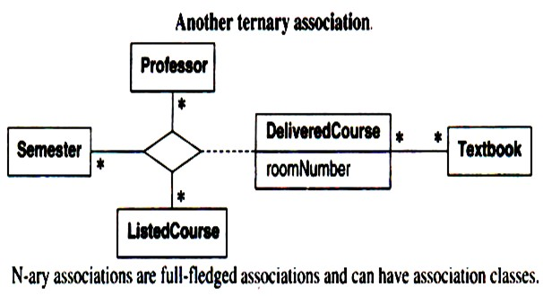
Example: ternary association
When an n-ary association is promoted to a class, the meaning of a model is changed. An n-ary association enforces that there is at most one link for each combination-for each combination of Professor, Semester, and ListedCourse in the following non-promoted figure, there is one DeliveredCourse.

Slide 23
4.Aggregation
◆
Aggregation is a part of association
◆
It is used to represent whole-part relationship. It is normally posses has-a relationship
◆
If two objects are tightly bound by a part-whole relationship, it is an aggregation.
If two objects are usually considered as independent, even though they may often be linked, it is an association.
Aggregation is drawn like association, except a small diamond indicates the assembly end.
◆
◆
DVD Player
Car
Here, DVD player and car are the two classes that can be associated by aggregate relationship.
◆
◆
Here, Car can exists without DVD player and DVD player can be exists without car.
UML 38

Slide 24
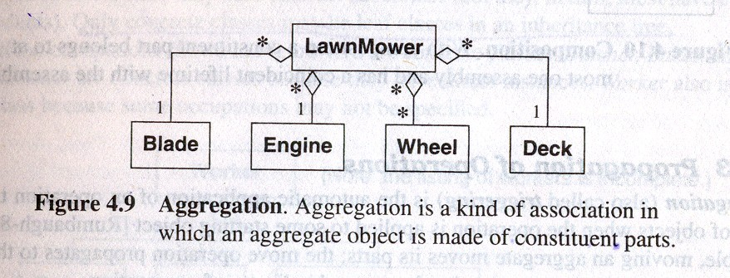
Aggregation
LawnMower consists of a Blade, an Engine, many Wheels, and a Deck. LawnMower is the assembly and the other parts are constituents. LawnMower to Blade is one aggregation, LawnMower to Engine is another aggregation, and so on. Each individual pairing is an aggregation so that multiplicity of each constituent part can be specified within the assembly. This definition emphasizes that aggregation is a special form of binary association.
Important properties: Transitivity and asymmetric
Transitivity means if A is a part of B and B is part of C, then A is a part of C.
Asymmetric if A is part of B then B is not part of A.

Slide 25
4.1 Aggregation Vs. Association
If two objects are tightly bound by a part-whole relationship, it is an aggregation.
If two objects are usually considered as independent, even though they may be often linked , it is an association.

Slide 26
4.2 Aggregation Vs. Composition
The UML has two forms of part-whole relationships: a general form called aggregation and a more restrictive form called composition.
◆
◆
Composition is a form of aggregation with two additional constraints.
(1) A constituent part can belong to at most one assembly.
(2) Once a constituent part has been assigned an assembly, assembly.
it has a coincident lifetime with the
◆
Thus composition implies ownership of the parts by the whole.

Slide 27
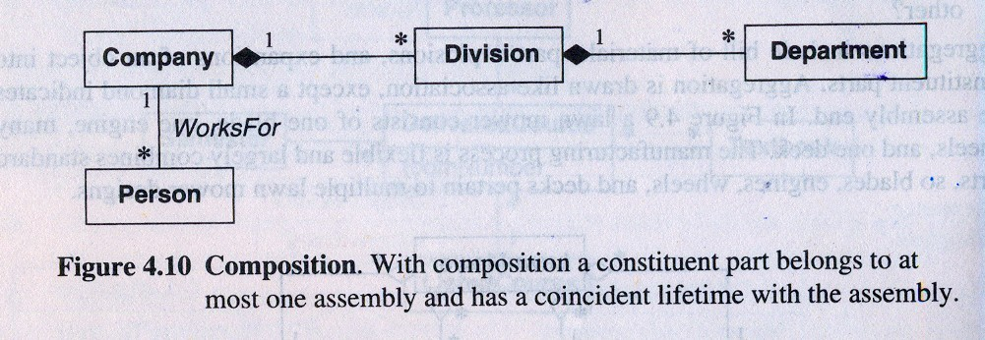
Aggregation Vs. Composition Continue…
→The notation for composition is a small solid diamond next to the assembly class.
→In below fig. a company consists of divisions, which in turn consist of departments.
Means company is indirectly a composition of departments.

Slide 28
Summary of Aggregation Vs. Composition
Aggregation Composition
Part can be shared by several wholes
Part is always a part of a single whole
*
*
category
document
Window
Frame
Parts can live independently (i.e., whole cardinality can be 0..*)
Parts exist only as part of the whole. When the wall is destroyed, they are destroyed
Whole is not solely responsible for the object
Whole is responsible and should create/destroy the objects

Slide 29
4.3 Propagation/Triggering of operations
Propagation (Also called Triggering) is the automatic application of an operation to a network of objects when the operation is applied to some starting object.
Propagation of operations to parts is often a good indicator of propagation.
Propagation is very well applicable to aggregated objects, operation carried on whole eventually changes the states of sub objects.

Slide 30
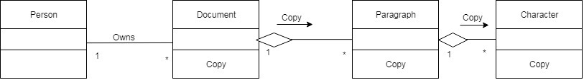
E.g. A person owns multiple documents. Each document consists of paragraphs that, in turn, consist of characters. The copy operation propagates from documents to paragraphs to characters. Copying a paragraph copies all the characters in it. The operation does not propagate in the reverse direction; a paragraph can be copied without copying the whole document. Similarly, copying a document copies the owner link but does not spawn a copy of the person who is owner.

Slide 31
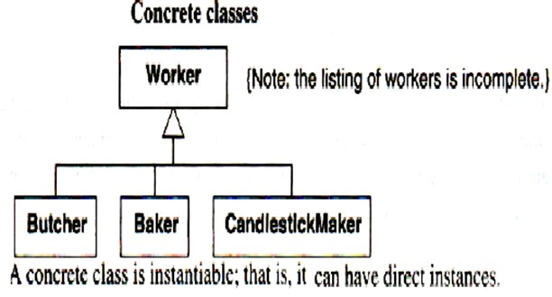
5.Abstract Classes
→An abstract class is a class that has no direct instances but whose descendant classes have direct instances.
→A concrete class is a class that is instantiable that means it can have direct instances.
Only concrete classes may be leaf classes in an inheritance tree. Butcher;Baker; and CandlestickMaker are concrete classes because they have direct instances. Worker also is a concrete class because some occupations may not be specified.
→

Slide 32
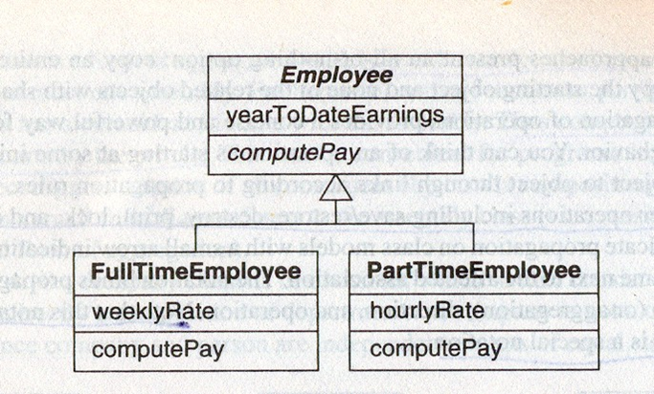
In UML notation an abstract class name is listed in an italic font or by placing the keyword {abstract} below or after the name.
Example of Abstract class:
All employees must be either full-time or part-time. FullTimeEmployee and PartTimeEmployee are concrete classes because they can be directly instantiated.

Slide 33
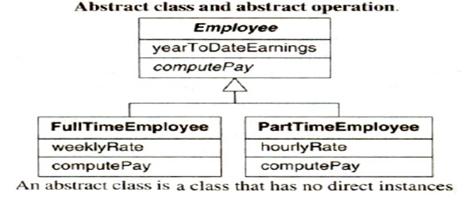
Abstract operation
Abstract classes can define signature for an operation without supplying a corresponding method.
The concrete subclass must provide implementation of signature of the operation
An abstract operation is designated by italics or the keyword {abstract}. ComputePay is an abstract operation of class Employee; its signature but not its implementation is defined. Each subclass must supply a method for this operation.

Slide 34
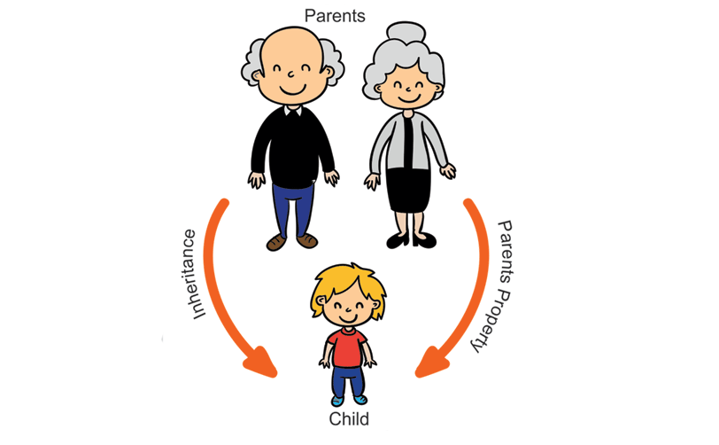
6.Multiple Inheritance
Multiple Inheritance permits a subclass to inherit features from
more than one superclass.
Advantages:
Increased power in specifying classes
Increased opportunity for reuse
Disadvantages:
Loss of conceptual and implementation simplicity.

Slide 35
Kinds of Multiple Inheritance
Multiple Inheritance from Disjoint Classes
Multiple Inheritance from Overlapping Classes

Slide 36
6.1 Multiple Inheritance from Disjoint Classes
Multiple inheritance from the set of disjoint classes allows a sub class to have each of its super class from a different set of disjoint classes.
Disjoint class
The two classes are said to be disjoint when there is no instance that can belong to both of these classes at a time.

Slide 37
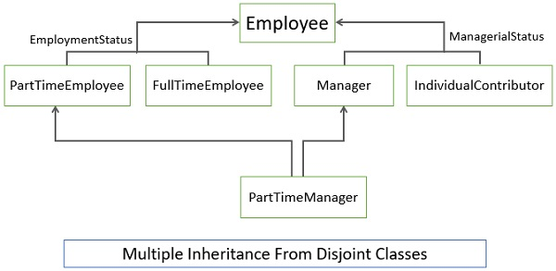
Multiple Inheritance from Disjoint Classes
In this figure, the classes FullTimeEmployee and PartTimeEmpolyee are the disjoint classes as an employee at one time can either be a full-time employee or he can be a part time employee, he can not be both at a time. So, we conclude that the classes FullTimeEmployee and PartTimeEmpolyee are disjoint classes. Similarly, Manager and IndividualContributor are also disjoint and each employee must be one or the other. The model does not show it, but we could define three additional combinations: FullTimeManager, PartTimelndividualContributor, and PartTimeManager.

Slide 38
Each generalization should cover a single aspect
Multiple generalizations must be used if a class can be refined on several distinct and independent aspects.
E.g. In previous figure, classEmployee independently specializes on employment status and managerial status. Consequently the model has two separate generalization sets.

Slide 39
A subclass inherits a feature from the same ancestor class found along more than one path only once; it is the same feature. E.g. in the previous figure, FullTimelndividualContributor inherits Employee features along two paths, via employmentStatus and managerialStatus. However, each FullTimelndividualContributor has only a single copy of Employee features.

Slide 40
Conflicts among parallel definitions create ambiguities that implementations must resolve. In practice, such conflicts should be avoided or explicitly resolved in models, even if a particular language provides a priority rule for resolving conflicts.
E.g. Suppose that FullTimeEmployee and IndividualContributor both have an attribute called name. FullTimeEmployee.name could refer to the person's full name while IndividualContributor.name might refer to the person's title. In principle, there is no obvious way to resolve such clashes. The best solution is to try to avoid them by restating the attributes as FullTimeEmployee.personName and IndividuaIContributor.title.

Slide 41
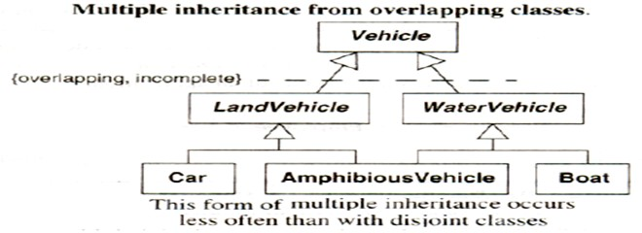
6.2 Multiple Inheritance from Overlapping Classes
In figure, AmphibiousVehicle is both LandVehicle and WaterVehicle. LandVehicle and WaterVehicle overlap, because some vehicles travel on both land and water. The UML uses a constraint (Section – Constraints) to indicate an overlapping generalization set; the notation is a dotted line cutting across the affected generalizations with keywords in braces. In this example, overlapping means that an individual vehicle may belong to more than one of the subclasses. Incomplete means that all possible subclasses of vehicle have not been explicitly named.
Notes:
here can occur multiple inheritance with the overlapping classes. Now, what are the overlapping classes? The two sub classes are the overlapping classes if they can behave in both aspects of the super class.
Let us take an example, as you can see in the figure below the class LandVehicle and the class WaterVehicle are the overlapping classes as there are some vehicles that can travel on both, land as well as water. So, a vehicle can be both lands as well as water vehicle.

Slide 42
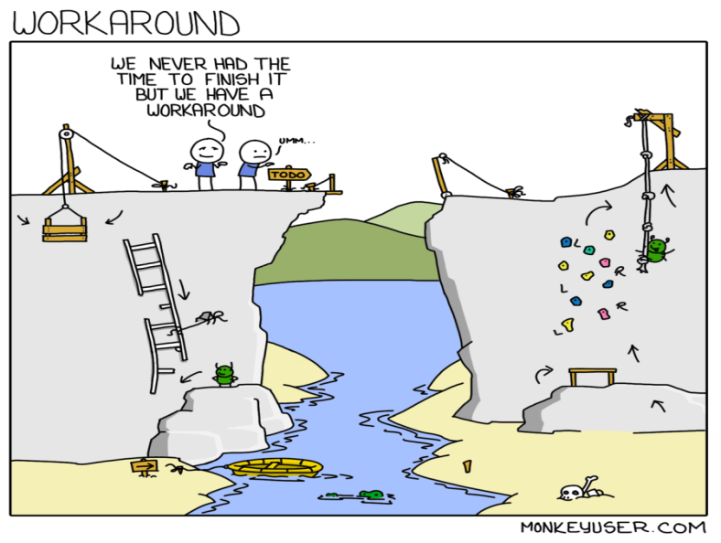
6.3Workarounds
While designing the class model if you sense the absence or lack of multiple inheritance then it could be the implementation fault. Well, this could be resolve while early restructuring of the class model. In the section below we will list out some restructuring techniques.
Delegation: It is an implementation mechanism by which an object forwards an operation to another object for execution.

Slide 43
6.3.1. Delegation Using Composition of Parts
Implementing delegation means allowing objects to forward their operation to another object for execution. For example, look at the figure below the Employee class is a composition of EmployeeEmployment and EmployManagement. Whenever the object of Employee class is operated, the operation would be redirected either to EmployeeEmployment or EmployeeManagment.
This denotes delegation using the composition of parts.

Slide 44
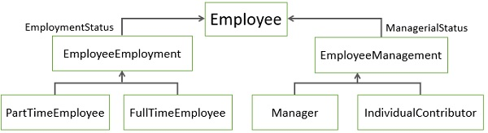
6.3.2Workaround for multiple inheritance-Delegation

Slide 45
2. Inherit the Important and Delegate the Rest
The important generalization is preserved and remaining generalization is degraded while their operations are delegated to the other object.
3. Nested Generalization
If a class can be explored in many aspects then explore it on one aspect completely first and then explore the other. This approach retrieves all the possible combinations.
4. Super Classes of Equal Importance
A subclass may have more than one super class and all may be of equal importance then using delegation is the best method to preserve the symmetry of the model.

Slide 46
5. Dominant Super Class
If there is one dominating superclass then preserve the inheritance through that path.
6. Few Subclasses
In the class model, if there are few subclasses then opt for nested generalization. For the larger subclasses avoid generalization.
7. Sequencing Generalization Sets
The nested generalization must be implemented sequentially, the most important aspect is explored first, then second and so on.

Slide 47
8. Large Quantities of Code
The nested generalization reduces the quantities of code.
9. Identity
Preserve the identity in the class model using a nested generalization.

Slide 48

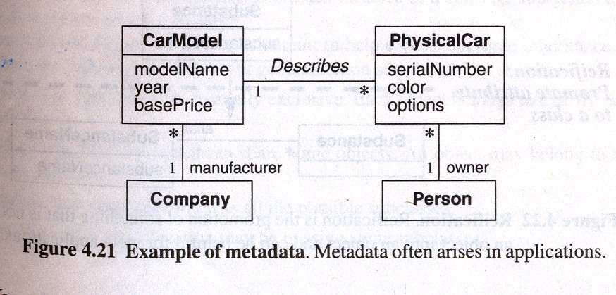
7.Metadata
→Metadata is data that describe other data.For example, a class definition is
metadata and models are also metadata.
→Many real world applications have metadata,such as catalogs,dictionary etc.
→Following fig. shows an example of metadata.

Slide 49
8. Reification
Promotion of something that is not an object into an object
Useful to promote attributes, methods, constraints and control information into objects, so that it can be manipulated and described as data
As an example of reification, consider a database manager. A developer could write code for each application so that it can read and write from files. Instead, for many applications, it is better idea to reify the notion of data services and use a database manager. A database manager has abstract functionality that provides a general purpose solution to accessing data reliably and quickly for multiple users.

Slide 50

9. Constraints
A constraint is a Boolean condition involving model elements such as
objects, classes, attributes, links, associations and generalization sets.
◆
◆
A constraint restricts the values that elements can assume.
◆
We can define constraints on following:
On objects
On links
◆
UML has two notations for constraints.
braces { }
dog-eared comment box
constraint
UML 45

Slide 51
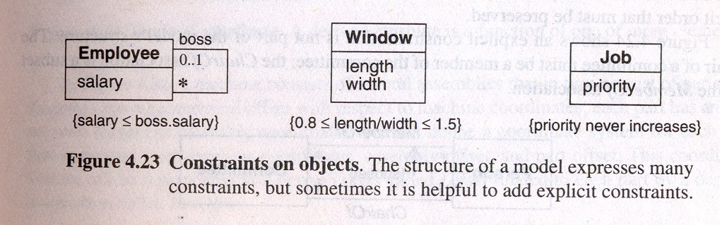
Constraints on objects
→Following fig. shows several examples of constraints.
→First fig. shows a constraint between two things at the same time.
→Second fig. shows a constraints between attributes of the single object.
→Third fig. shows constraint on the same object over time.

Slide 52
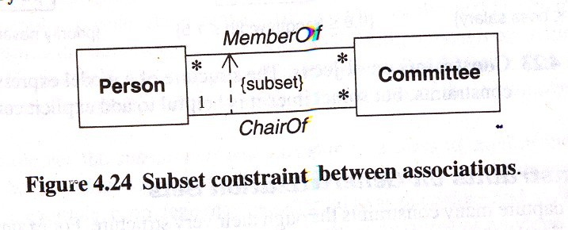
Constraints on Links
→example

Slide 53
How to draw class diagram?
https://www.youtube.com/watch?v=UI6lqHOVHic&t=16s

Slide 54
Example
Prepare a class model to describe geographical map. Map contains roads, rivers and mountains. All components are described by points representing longitude and latitude.

Slide 55
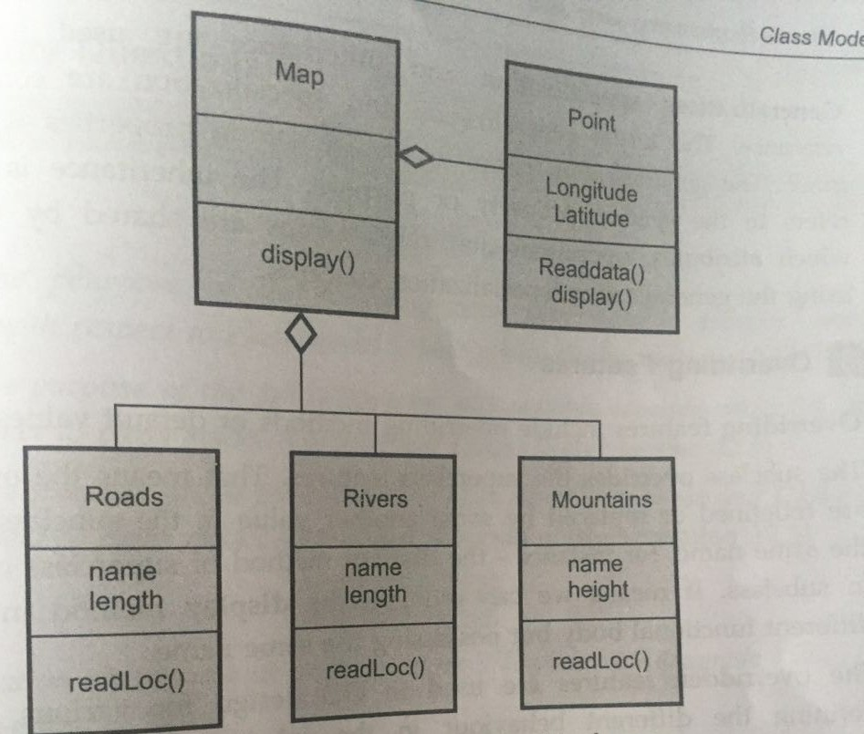
Solution

Slide 56
Example
Prepare a class diagram for each group of classes. Add at least 10 relationships (associations and generalizations) to each diagram.
◆ File system, file, ASCII file, binary file, directory file, disc, drive, track, sector

